Slide 1


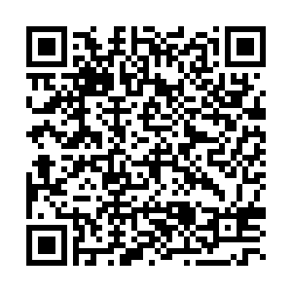
504 Plans
EPS Basics
& Beyond
Process & Flowcharts
Special Programs
  Required Forms
  Pro Tips
Finalizing
Points of Interest

Slide 2

TABLE OF CONTENTS
Required forms within 504 process in EPS
504 Plans & Process
  Flowcharts
  Steps
Individual Health Plan (IHP) 504
Transitory Impairment (Temporary 504)
Manifestation Determination
Special Programs | Pro Tips
Points of Interest | Self-Assessment
Additional Resources

Slide 3

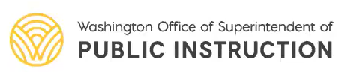
SECTION 504

Slide 4

SECTION 504

Slide 5

Required Forms within 504 Process
Forms for Standard 504 Process
504-4 | Parent or guardian consent to evaluate
504-5 | Determination of Eligibility (evaluation form)
504-6 | Eligibility or non-eligibility notice
If eligible for a 504 plan,
  504-8 | Classroom-based, academic-related accommodations
  504-11 | Non-classroom based, medical-related accommodations
Forms for Standard 504 Process
504-9 | Termination of 504 Services form
504-10 | Manifestation Determination form

Slide 6
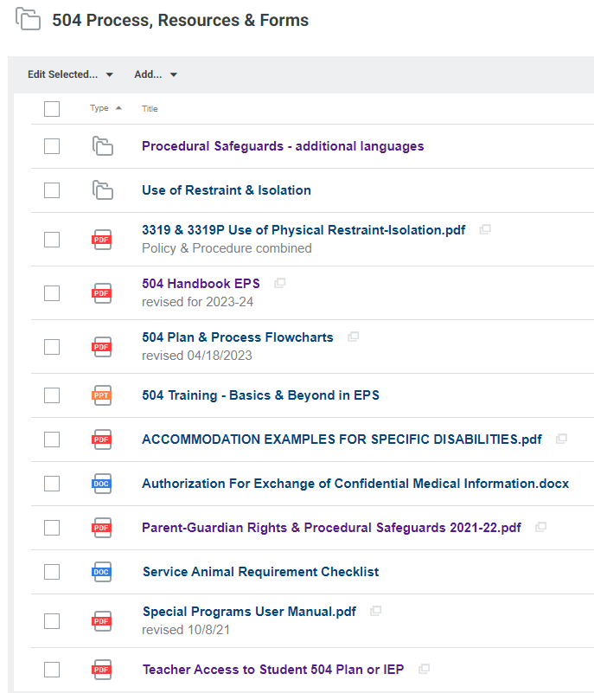
504 Resources in Docushare
Docushare is located in your “managed bookmarks”
You can access the 504 and counseling-related resources by going to:
→ EPS Documents
→ Departments
→ Student Support Services
Or bookmarking these folders:
504 Process, Resources & Forms
Counseling

Slide 7
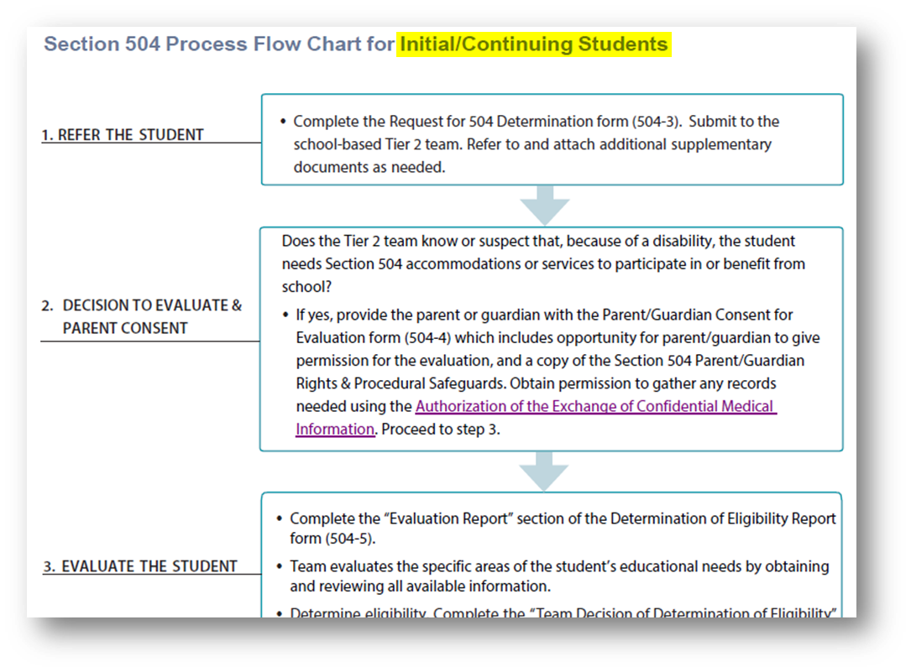
504 Plans & Process Flowcharts
Click here for a PDF of the full 504 Process Flowchart

Slide 8
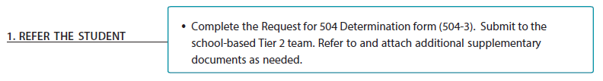
REFERRAL
OSPI NOTE:
A school must conduct a free evaluation of any student who—because of a disability—needs or is believed to need accommodations, aids, or services. If staff perceive or receive information to lead them to suspect a student has a disability, the LEA must evaluate the student.

Slide 9
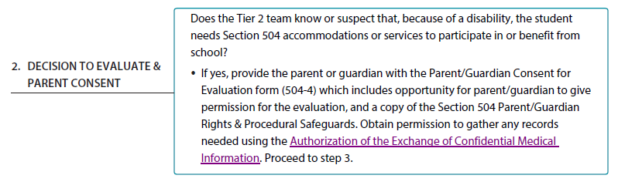
PARENT/GUARDIAN CONSENT
OSPI NOTE:
The school must have consent from a parent or guardian before the evaluation begins. Without consent, a 504 team cannot evaluate a student or continue the 504 process.

Slide 10
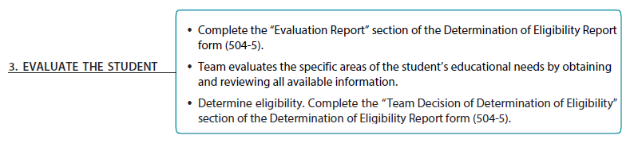
EVALUATION
OSPI NOTE:
One person cannot make evaluation or placement decisions alone. The team must include people who are knowledgeable about the student, who understand the meaning of the evaluation data, who are knowledgeable about placement options, and/or who can make financial decisions (if costs are anticipated).

Slide 11
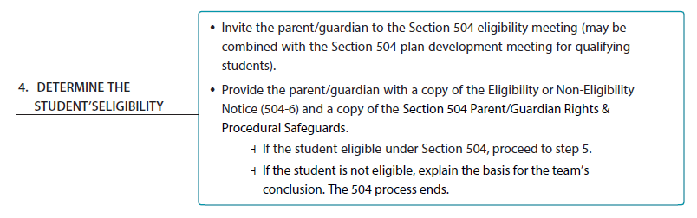
DETERMINE ELIGIBILITY
OSPI NOTE:
Section 504 does not give parents/guardians the right to participate in a meeting during which their child’s program is designed and placement is determined, as does the IDEA. However, if a meeting is held, this practice is recommended.

Slide 12
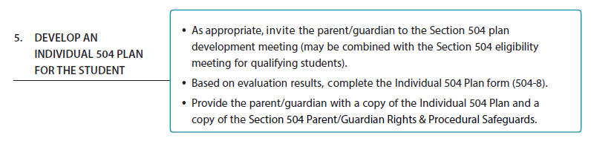
DEVELOP THE PLAN
OSPI NOTE:
With the 504 plan in place, all school staff members follow the plan to accommodate the student. It is the school’s responsibility – not the student’s or parent’s – to make sure teachers are aware of the services, aids, or accommodations in the plan.

Slide 13
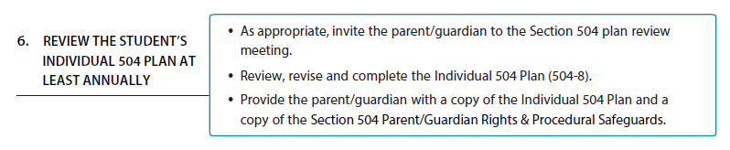
REVIEW
OSPI NOTE:
Although not a legal requirement, best practice in EPS is for teams to review Section 504 plans annually, or as needed when there are significant changes or transitions.

Slide 14
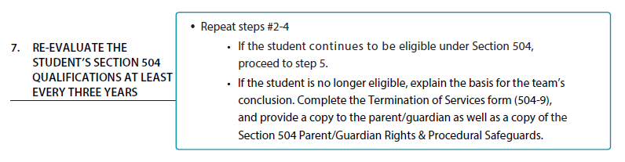
RE-EVALUATION
OSPI NOTE:
The team must re-evaluate the student at least every 3 years. or more often if deemed appropriate or necessary.

Slide 15
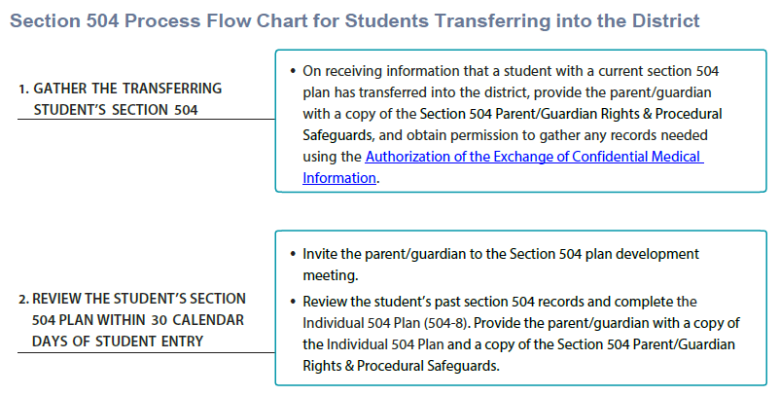
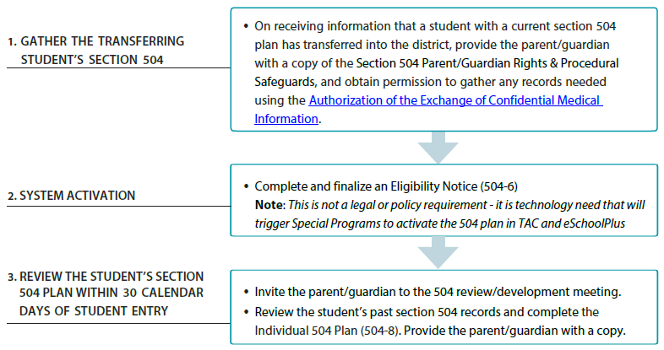
STUDENTS NEW TO EPS | EXISTING 504 PLAN

Slide 16
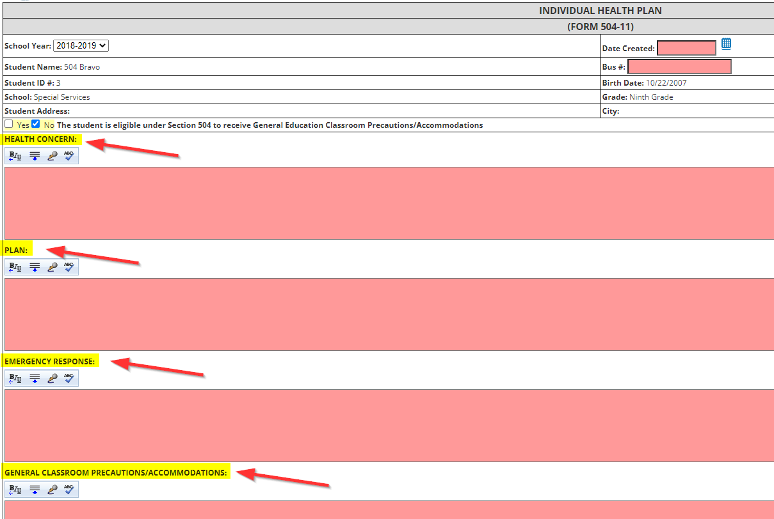
INDIVIDUAL HEALTH PLAN | FORM 504-11

Slide 17
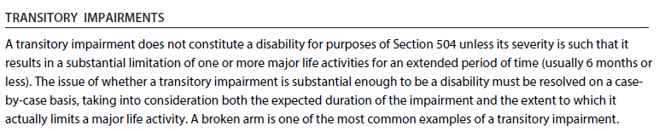

TEMPORARY 504 PLANS
When eligible, this is considered to be a “Temporary 504 Plan”

Slide 18
TEMPORARY 504 PLANS
Within the Individual 504 Plan (Form 504-8), be sure to:
Indicate that it is a “temporary 504 plan”
Include an anticipated ending date and/or criterion
For example:
“Because the substantial impact of Daijin’s impairment is anticipated to be transitory (less than 6 months), this 504 plan is temporary. The accommodation(s) will be in place through February 3, 2023 [and/or] until Daijin is able to walk up/downstairs without assistance. Their status will be reevaluated in advance of this date.”

Slide 19
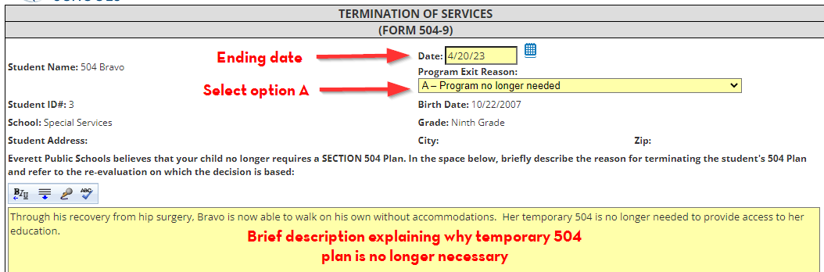
TEMPORARY 504 PLANS
When the temporary 504 is no longer needed:
Complete and finalize the Termination of Services form (504-9)
Provide a copy to the parent/guardian as well as a copy of the Section 504 Parent/Guardian Rights & Procedural Safeguards.

Slide 20
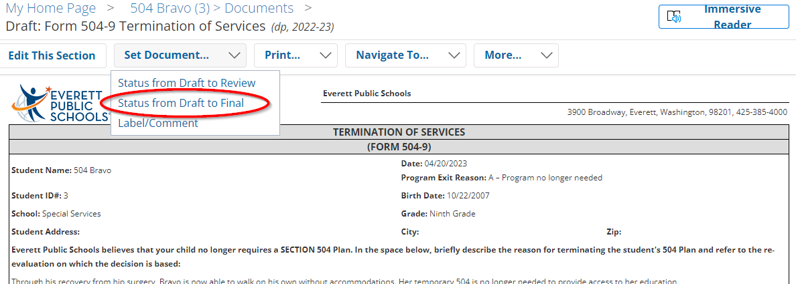
TEMPORARY 504 PLANS
When the temporary 504 is no longer needed:

Slide 21
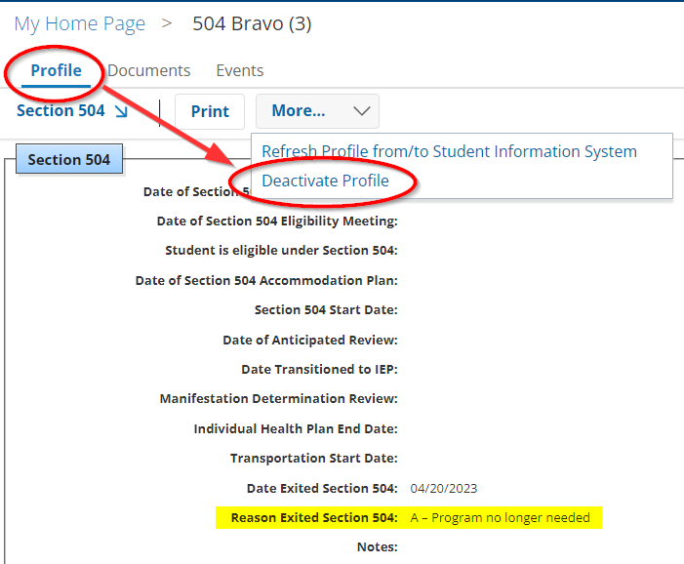
TEMPORARY 504 PLANS
When the temporary 504 is no longer needed:

Slide 22
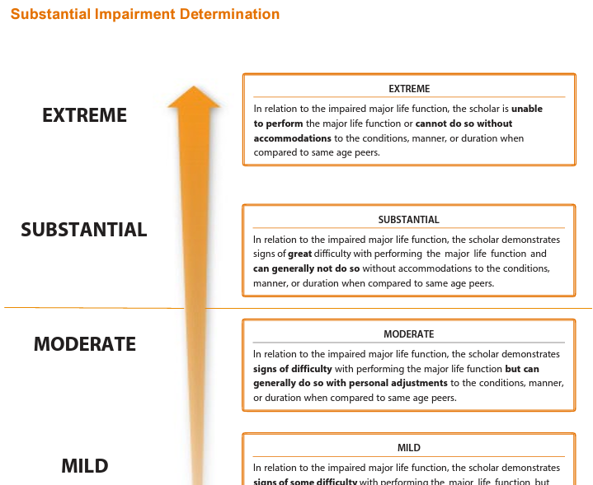
504 PLANS & PROCESS FLOWCHARTS
Pg. 4
Click here for a PDF of the full 504 Process Flowchart

Slide 23
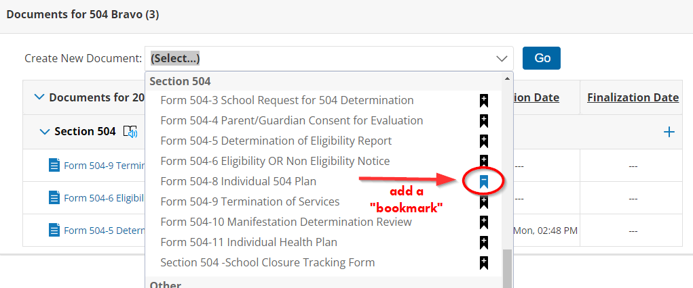
USING SPECIAL PROGRAMS | PRO TIPS
You can add a bookmark to frequently accessed forms

Slide 24
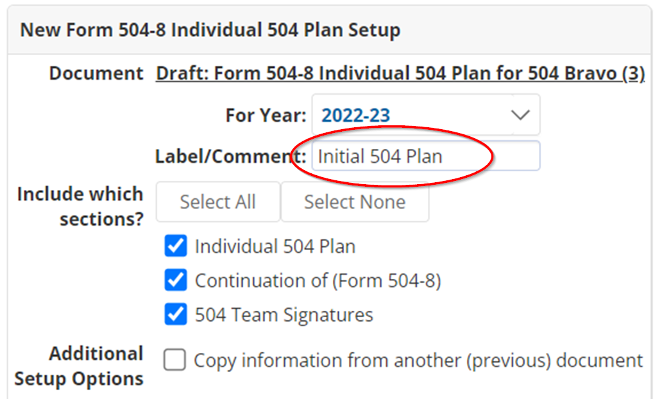
USING SPECIAL PROGRAMS | PRO TIPS
You can use a descriptive title if helpful (otherwise use your initials)

Slide 25
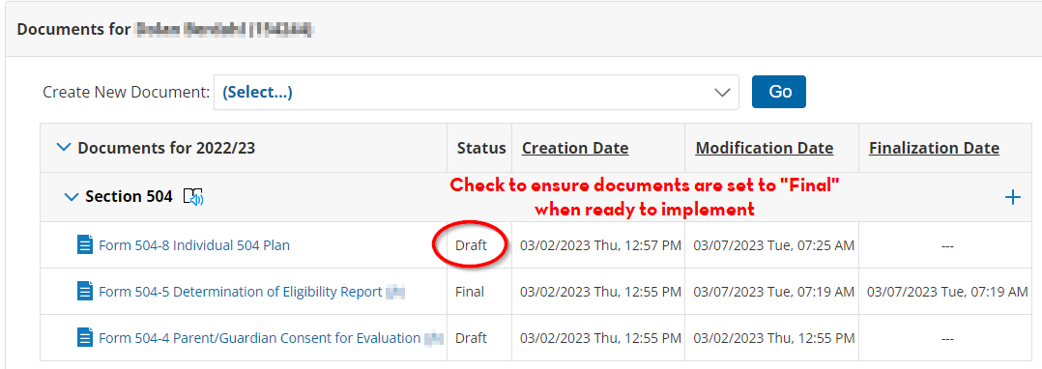
USING SPECIAL PROGRAMS | PRO TIPS
When the 504-8 is set to “final”
The plan will appear in TAC and eSchool
It can be pulled and uploaded into TIDE (for testing accommodations)

Slide 26
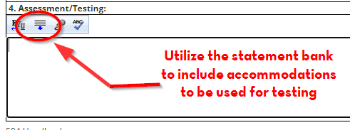
USING SPECIAL PROGRAMS | PRO TIPS
In the Assessment/Testing Section you must choose from the preloaded SBA accommodations in order for the accommodation to be pulled into TIDE
Custom-worded testing accommodations will not be uploaded to the state database

Slide 27
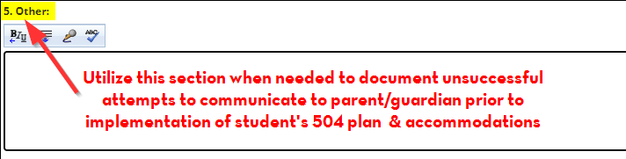
USING SPECIAL PROGRAMS | PRO TIPS
Although consent to evaluate is the only required parent/guardian component, parents/guardians must be notified of the 504 placement decisions, accommodations, and plan review

Slide 28
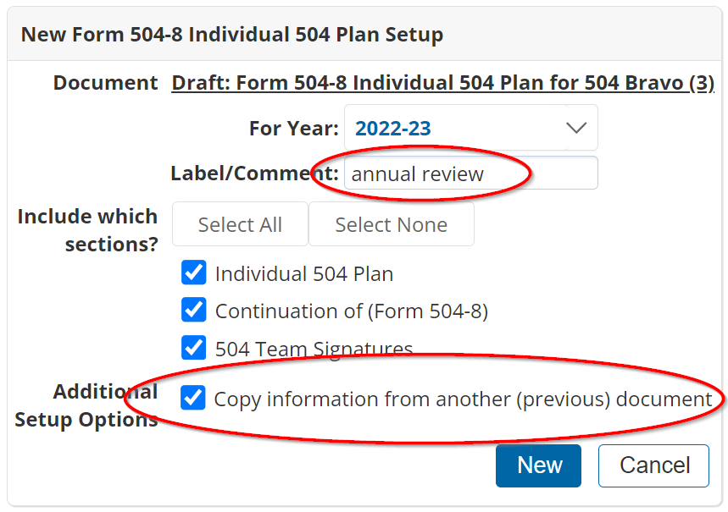
504 PLAN REVIEW
For an annual review, you have the option of copying the current finalized 504 plan and making edits as appropriate or indicating no changes are necessary.

Slide 29
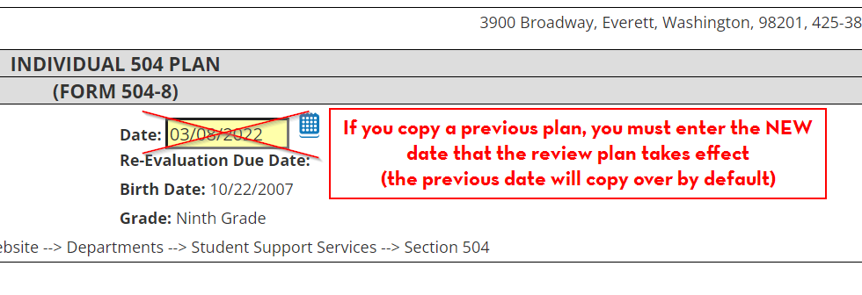
504 PLAN REVIEW
From the copied plan, replace the previous implementation date with the date the 504 review was completed, and any/all changes were updated

Slide 30
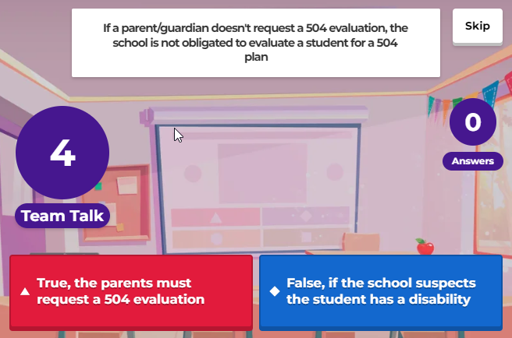
POINTS OF INTEREST | Responsibility to Refer
Anyone, including a parent or guardian, can refer a student for evaluation. Schools have a special responsibility to make a Section 504 referral for every student they know or suspect has a disability and may need accommodations, aids, or services.

Slide 31
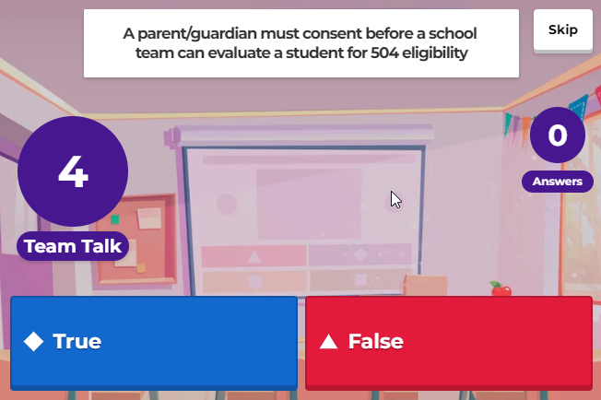
POINTS OF INTEREST | Consent to Evaluate
The school must have consent from a parent or guardian before the evaluation begins. Without consent, a 504 team cannot evaluate a student or continue the 504 process.

Slide 32
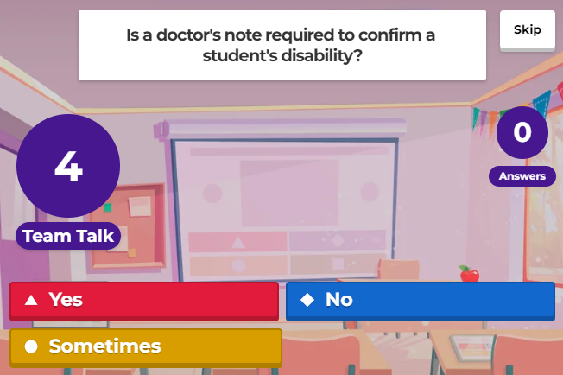
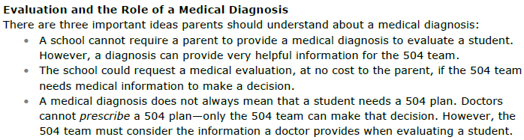
POINTS OF INTEREST | Doctor’s Notes

Slide 33
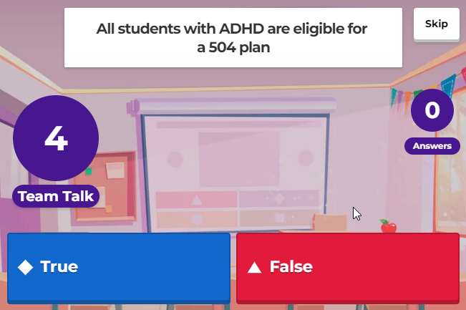
POINTS OF INTEREST | ADHD
Remember, students who are entitled to a 504 plan (1) have a physical or mental impairment which substantially limits one or more major life activities, and (2) need accommodations, aids, or services—because of their disability—so they can access and benefit from their education.
Since some students with ADHD will not meet the threshold of #1, #2, or both, not ALL will be eligible for a 504 plan.
Resource Guide on Students with ADHD

Slide 34
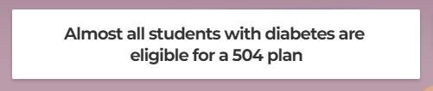
POINTS OF INTEREST | Diabetes
Since 2009, amendments and regulations under the Americans with Disabilities Act make clear that diabetes is a disability since it substantially limits the function of the endocrine system.
Guidelines for Care of Students with Diabetes

Slide 35
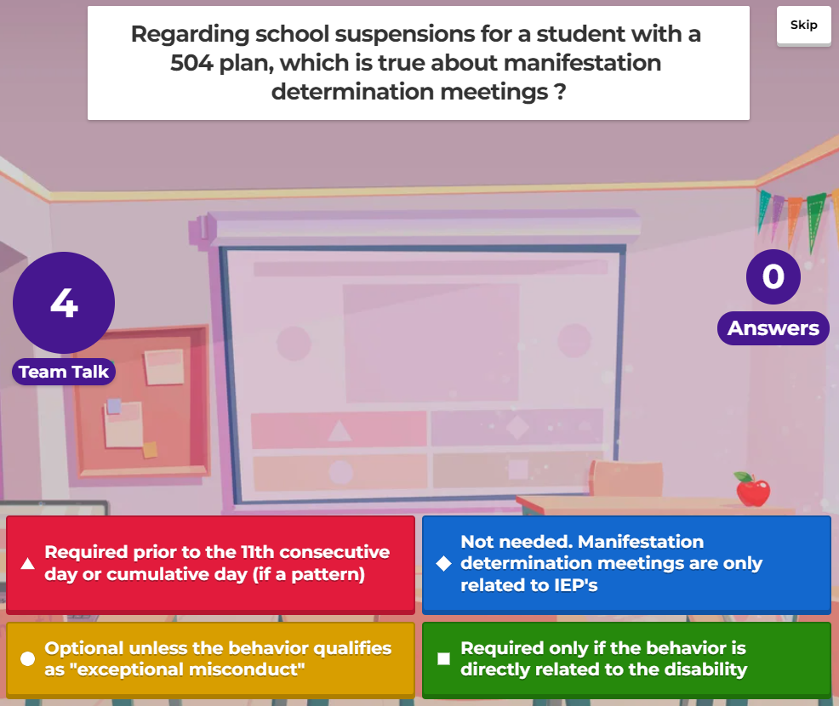
POINTS OF INTEREST | Manifestation Determinations
Note: This is one of the purposes of the manifestation meeting (which is why it wasn’t the correct answer)

Slide 36
POINTS OF INTEREST | Manifestation Determinations
Use form 504-10 for manifestation determinations
Long-Term Removals
If the student is being removed 10 or more consecutive days, the school must conduct a manifestation determination.
Short-Term Removals
If the student is removed less than 10 total school days in a school year, no manifestation is required.
If the student is removed for 10 or more total school days in a school year, a manifestation determination may be required. For short-term removals, the school must conduct a manifestation determination when there is a “pattern of exclusion,” considering the length of each removal, the total days removed, and the proximity of removals to one another.

Slide 37
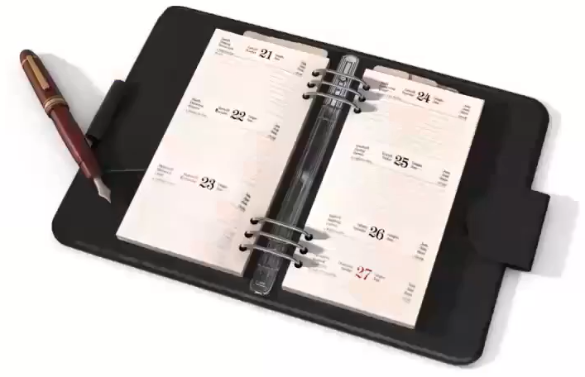
POINTS OF INTEREST | Manifestation Determinations
OSPI NOTE:
When conducting a manifestation determination, a Section 504 team must consider:
Was the conduct caused by, or did it have a direct and substantial relationship to, the child’s disability?
Was the conduct the direct result of the school’s failure to implement the Section 504 plan?
If the answer to either question is yes, the school cannot remove the student for the behavior. Rather, consider revisiting the Section 504 plan and conducting a re-evaluation.

Slide 38
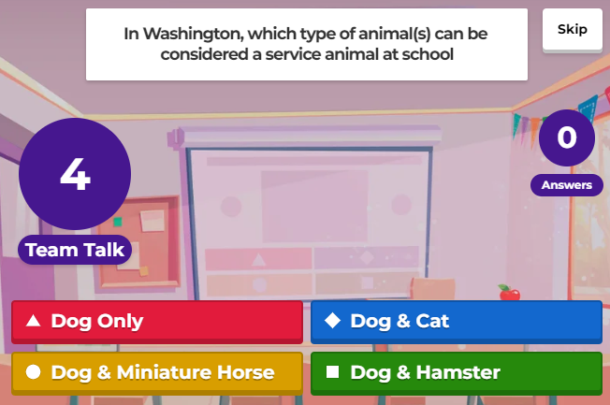
POINTS OF INTEREST | Service Animals

Slide 39
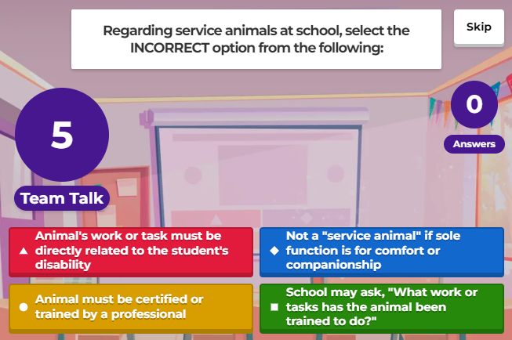
POINTS OF INTEREST | Service Animals

Slide 40
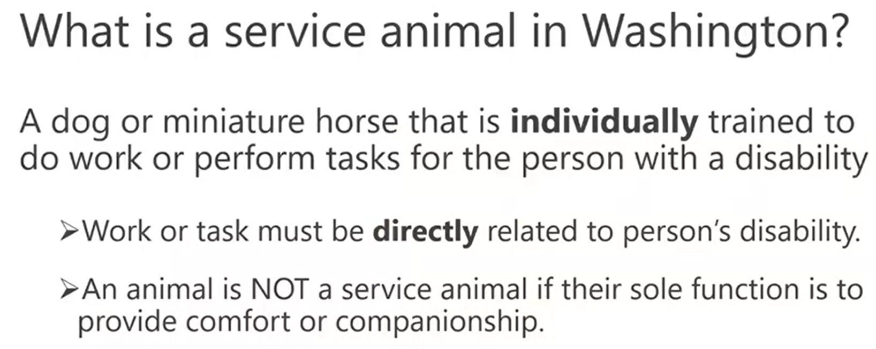
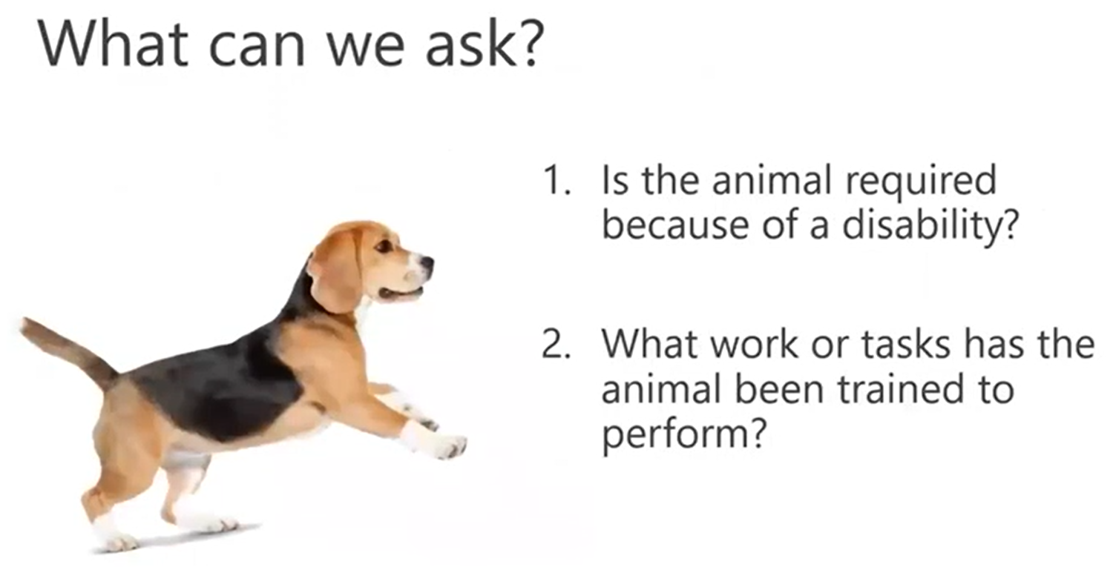
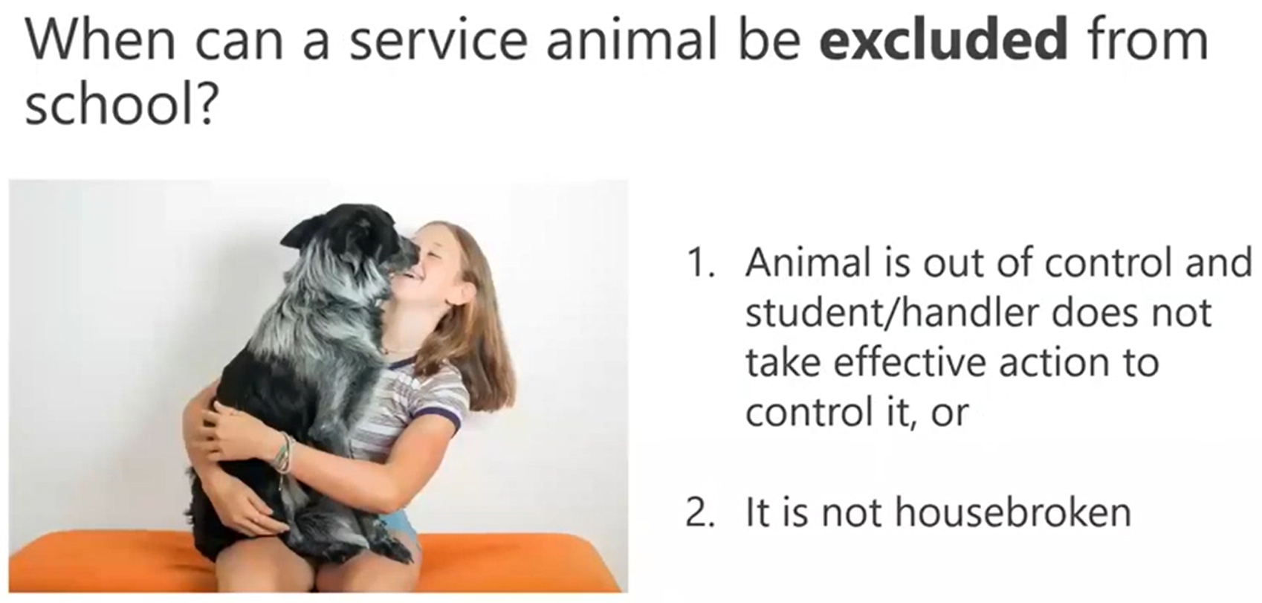
POINTS OF INTEREST | Service Animals
Click here for helpful EPS resources:
Service Animal Requirement Checklist | 2030P

Slide 41
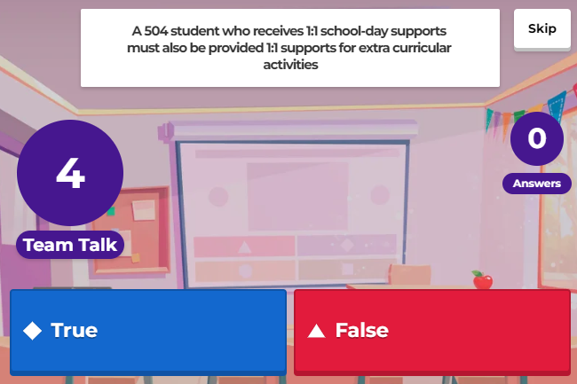
POINTS OF INTEREST | Extra-Curricular Support
Public schools must provide appropriate accommodations, aids, and services to eligible students who need these accommodations to participate in, and benefit from, their education. This includes all programs and activities sponsored by the school, such as sports and field trips.

Slide 42
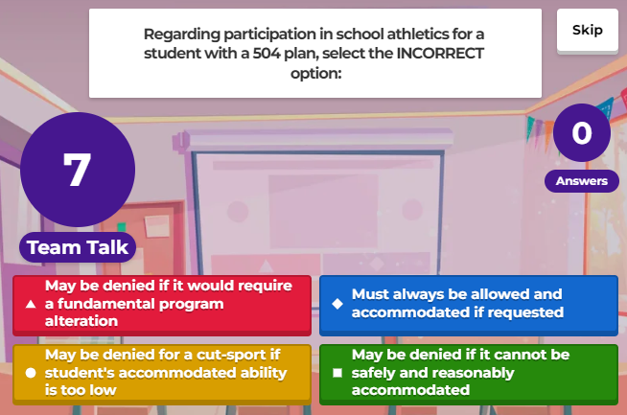
POINTS OF INTEREST | Extra-Curricular Support
School districts can require a level of skill or ability for a student to participate in sports, so long as the selection criteria are not discriminatory. That said, students with disabilities should be allowed to try out similarly to their non-disabled peers.

Slide 43
ADDITIONAL RESOURCES
Navigating Section 504 Webinar | Slide Deck Handout
Section 504: Beyond the Basics Webinar | Slide Deck Handout
OSPI’s Section 504 Resources for School Districts
OSPI’s Section 504 Resources for Families

